Slide 1

CASE STUDY
VOLKSWAGEN POLLUTION
SCANDAL
-: TEAM RAW :-
AGENT RINKAL
AGENT AJINKYA

Slide 2
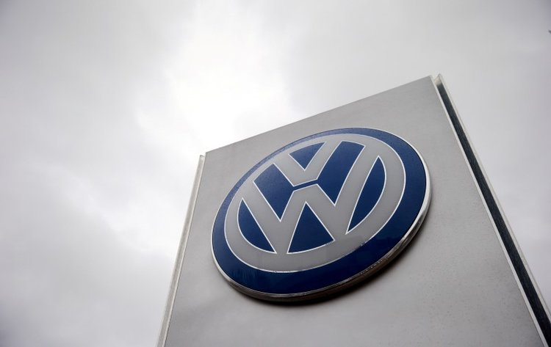
INTRODUCTION
German automaker founded on 28 May 1937 by the German Labor Front under Adolf Hitler and headquartered in Wolfsburg.
Flagship marque of the Volkswagen Group, the largest automaker by worldwide sales in 2016.
In 2011, Volkswagen was named in the top 25 largest companies in the world by the Forbes Global 2000.

Slide 3
WHAT WAS THE CASE
Volkswagen cheated nitrogen oxide emissions test as it emitted 40 times more NOx than the standard emission control.
Volkswagen not only disregarded EPA laws and restrictions but also invented software to avoid them.
It was significantly changing the fuel pressure, injection timing, exhaust-gas recirculation.

Slide 4

REASON BEHIND CASE
Dishonesty, lack of professionalism, and lack of responsibility
The company tried to avoid dissents and discussions as much as they could.
The rewarding system of Volkswagen to prefer keeping quiet about rigging in emission tests for a long time even if the employees prefer to reveal
Volkswagen may have wanted to avoid the cost of additional hardware, so it came up with a cheaper software fix.

Slide 5
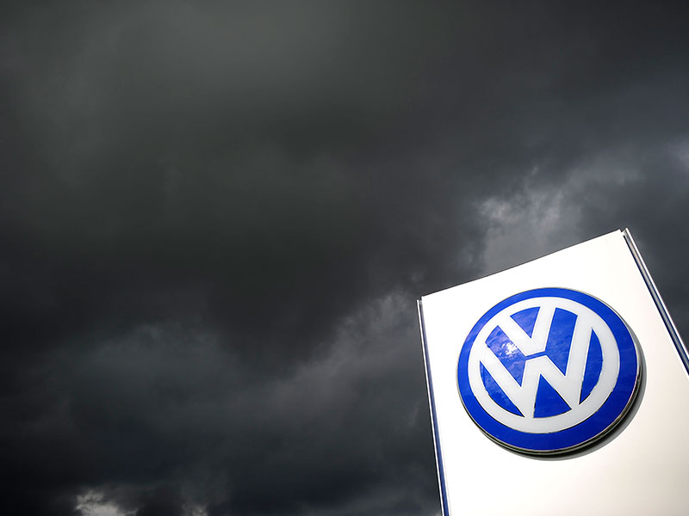
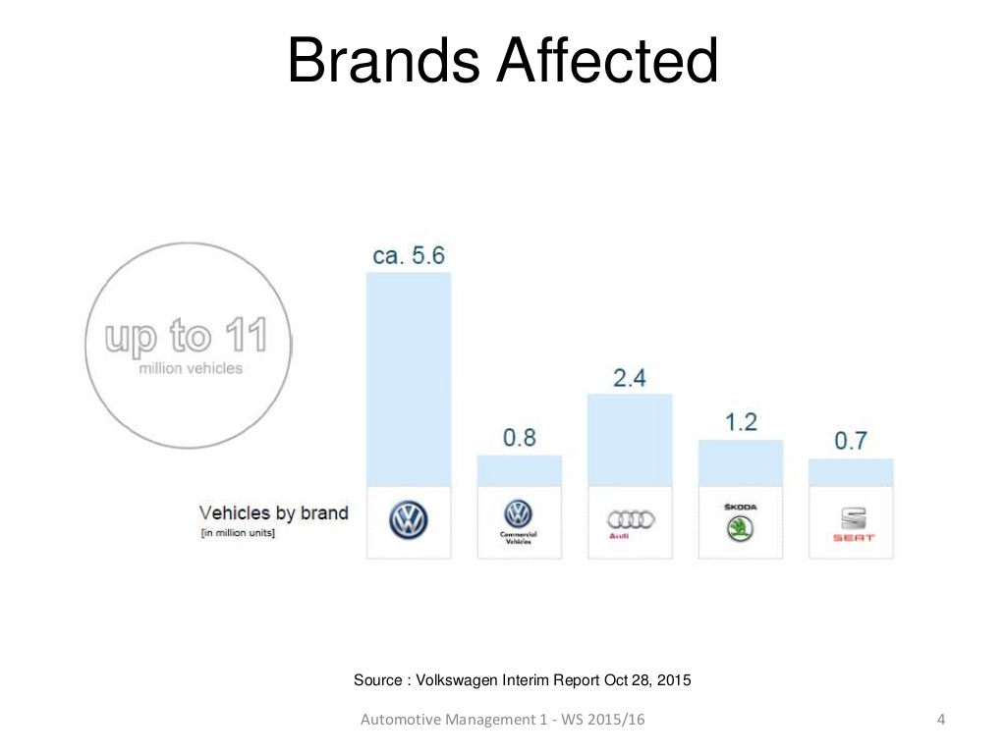
EFFECTS OF CASE

Slide 6
EFFECTS OF CASE
The company’s reputation damaged.
Global sales of Volkswagen declined.
Fine up to $18bn.
Loss of customers’ goodwill and trust.
Volkswagen vehicles were emitting an enormous amount of nitrogen oxides causing huge amount of air pollution.
Under U.S. based law firm from October, actions were taken against responsible department heads.

Slide 7
FURTHER STEPS BY VOLKSWAGEN
Volkswagen is conducting an internal investigation, aided by U.S. law firm Jones Day.
Martin Winterkorn, the CEO of VW Group resigned 5 days after the scandal broke out. Matthias Muller, CEO of Porsche has taken over
In U.S Volkswagen has promised owners $500 in cash plus $500 in gift cards -- at a cost of about $250 million.
VW suspended and Wolfgang Hatz Ulrich Hackenberg.

Slide 8
HOW TO HANDLE CRISIS
Recall of all the defeat devices.
Cleanup the NOx emissions in all affected cars.
Accept all mistakes and answer all the queries.
Try to restore the user’s faith and trust.
Launch new models which are environmental friendly.
Get wrongdoers out.

Slide 9
STEPS TO AVOID FURTHER CRISIS
Honesty, professionalism, and responsibility.
Product should be properly tested before launch.
Avoid cheaper technology.
Short profits must be ignored.
Customer’s satisfaction should be priority.
Introducing and inducing Code of Ethics for Software Engineers .
Involvement of independent third party for environmental certification.

Slide 10
Future plans for volkswagen
"My most urgent task is to win back trust for the Volkswagen Group - by leaving no stone unturned,”
- Mr. Matthias Muller(new CEO of Volkswagen)
Investment in environmental friendly technologies.
Increase focus on plug-in hybrids and electric vehicles.
Volkswagen will mandate new and stricter emissions testing which will be verified by an independent third party.

Slide 11
References
https://www.theguardian.com/business/2015/sep/18/epa-california-investigate-volkswagen-clean-air-violations
http://www.orlandosentinel.com/business/brinkmann-on-business/os-volkswagen-ceo-20150924-story.html
https://www.businessinsider.in/Theres-no-way-Volkswagen-is-going-to-pay-the-US-18-billion-in-fines-for-cheating-on-emissions-tests/articleshow/49050000.cms

Slide 12
!!! THANK YOU !!!

